Slide 1
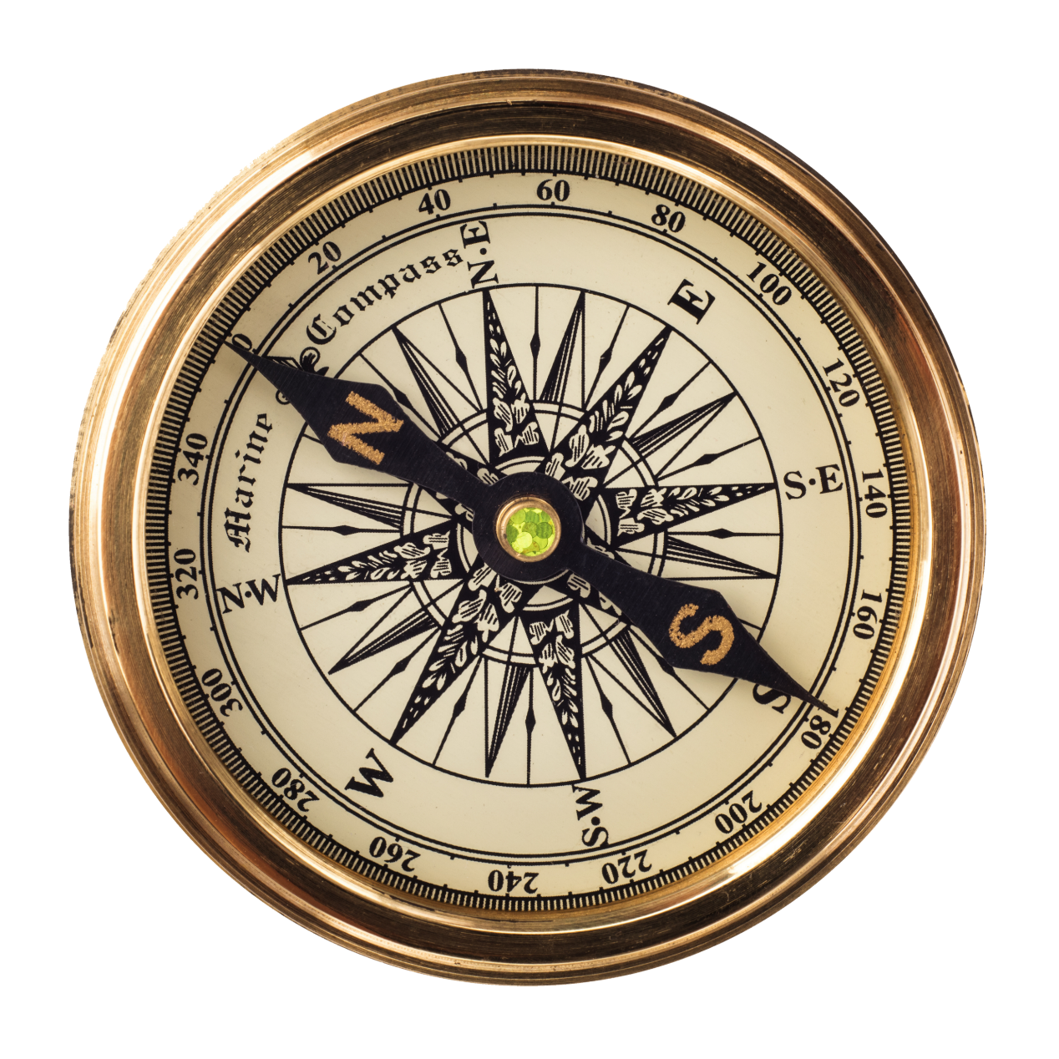
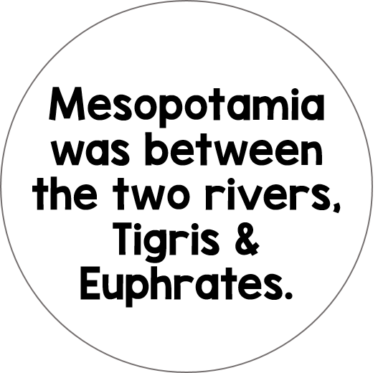
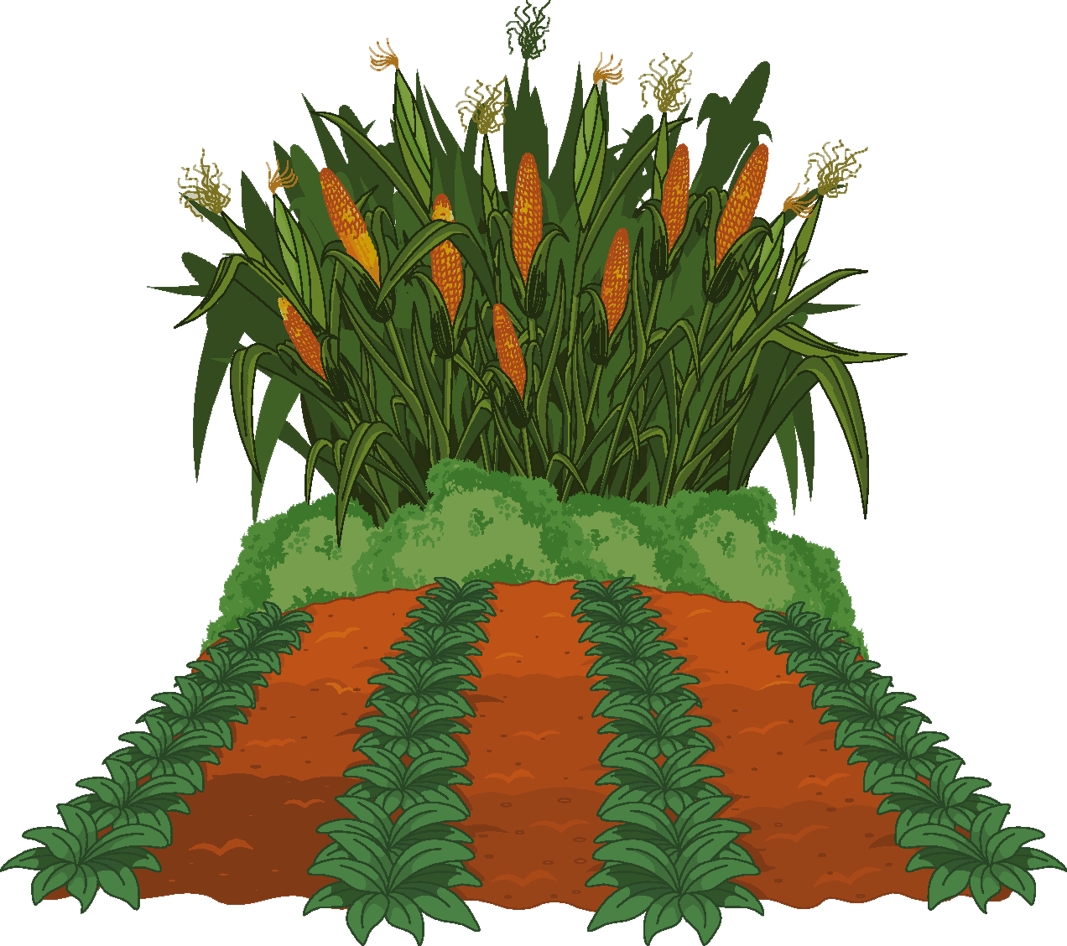
Mesopotamia was known as, “the land between two rivers”. The Sumerians developed the earliest civilization there around 3000 B.C.
The land in Mesopotamia had rich soil compared to the areas surrounding it. The rivers and fertile soil created an environment that was able to sustain life and civilization.

Slide 2
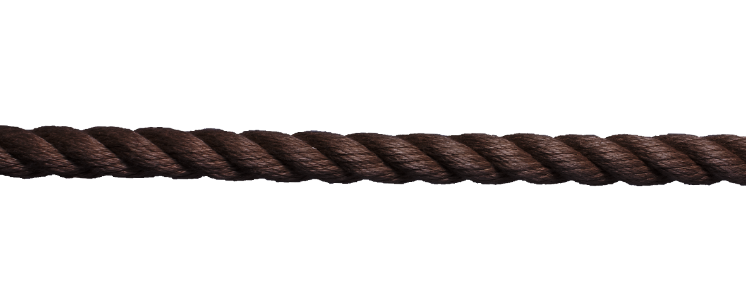
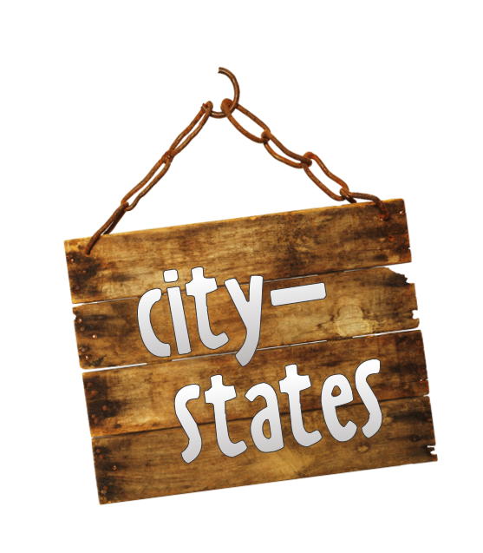
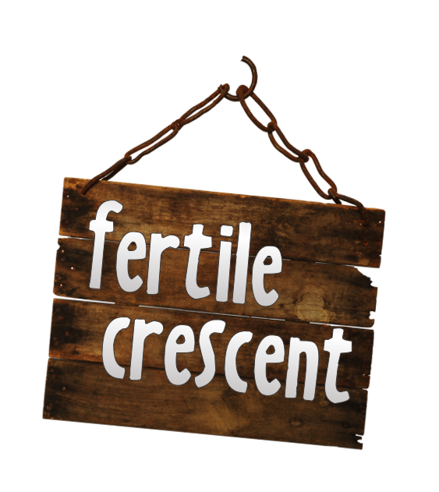
An area of fertile land in the Middle East, located by the Tigris and Euphrates Rivers. This is where ancient civilizations flourished.
A government where priests rule in the name of a god or gods. (divine right)
The basic units of Sumerian civilization – a small area surrounding a large city.
A temple where Sumerians believed gods and goddesses ruled the city. Ziggurats served as shrines.

Slide 3
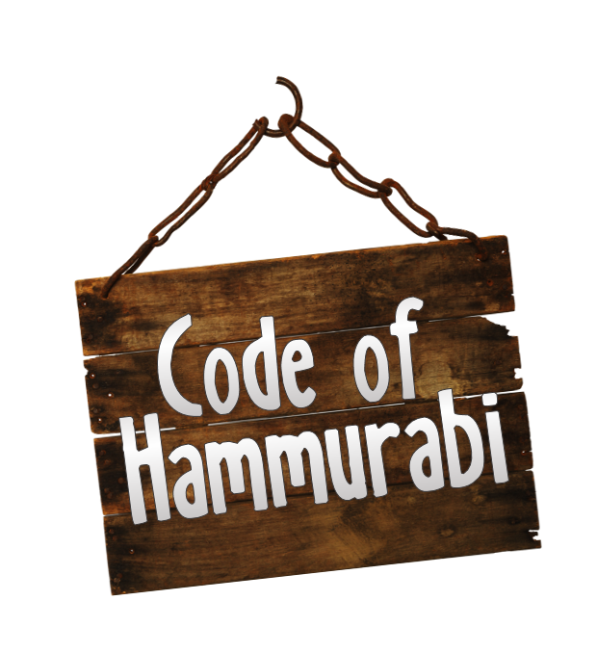
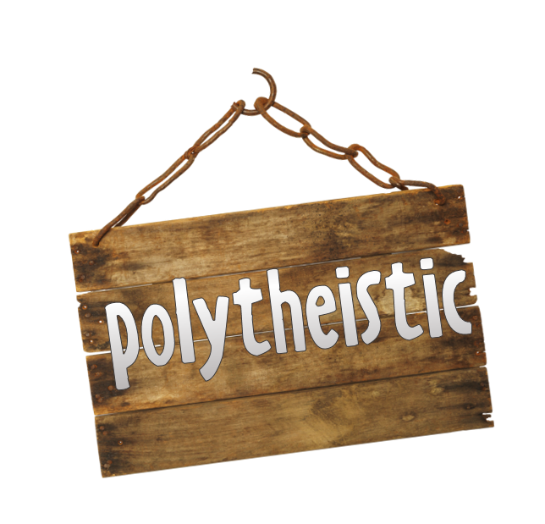
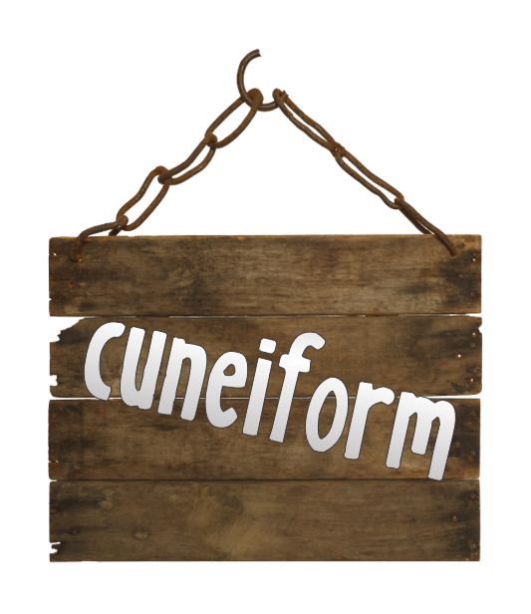
A group of states (or city-states) under a single authority.
A strict and harsh set of laws in ancient Mesopotamian times, created by the Babylonian king, Hammurabi.
Wedge-shaped writing on clay tablets. This was the writing system of the Sumerians.
To worship multiple gods or deities.

Slide 4
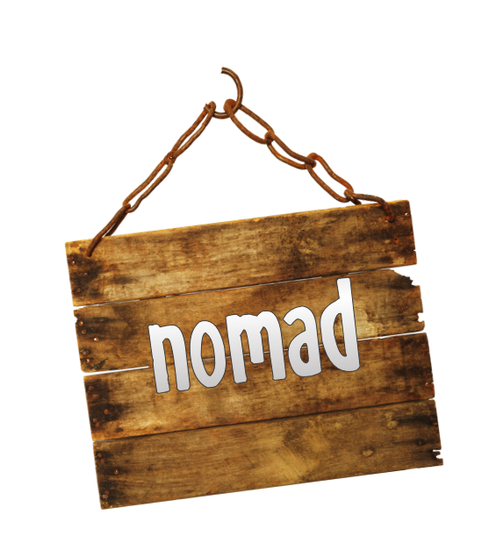
A society controlled by men, or a society that favors men. Women typically have very few privileges or rights.
A wanderer, someone who travels place to place without a permanent residence.

