Slide 1
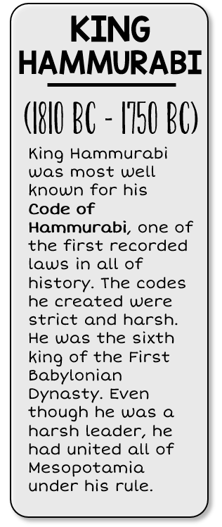
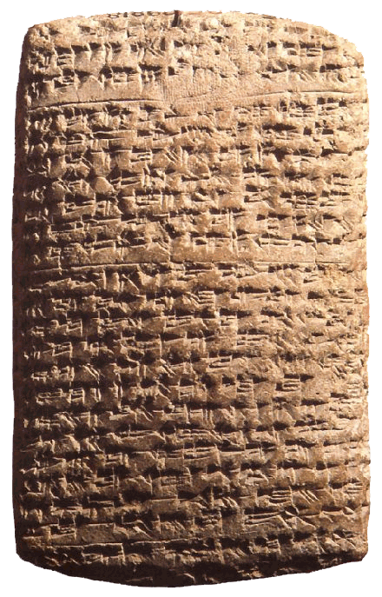
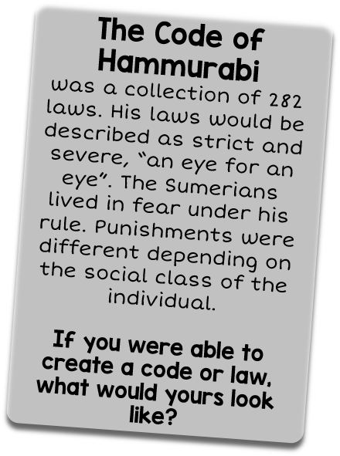

Slide 2
Sumerians arrive in Mesopotamia and create a civilization.
During this time, the Tigris & Euphrates rivers were discovered by nomads
Cuneiform
was developed
City-states were formed in Mesopotamia.

Slide 3
Hammurabi’s Law was developed,
First written law code
Akkadian’s first empire was created.
Hammurabi’s
rule of Ancient Mesopotamia
Nebuchadnezzar rule,
New Babylonian
times

