Slide 1
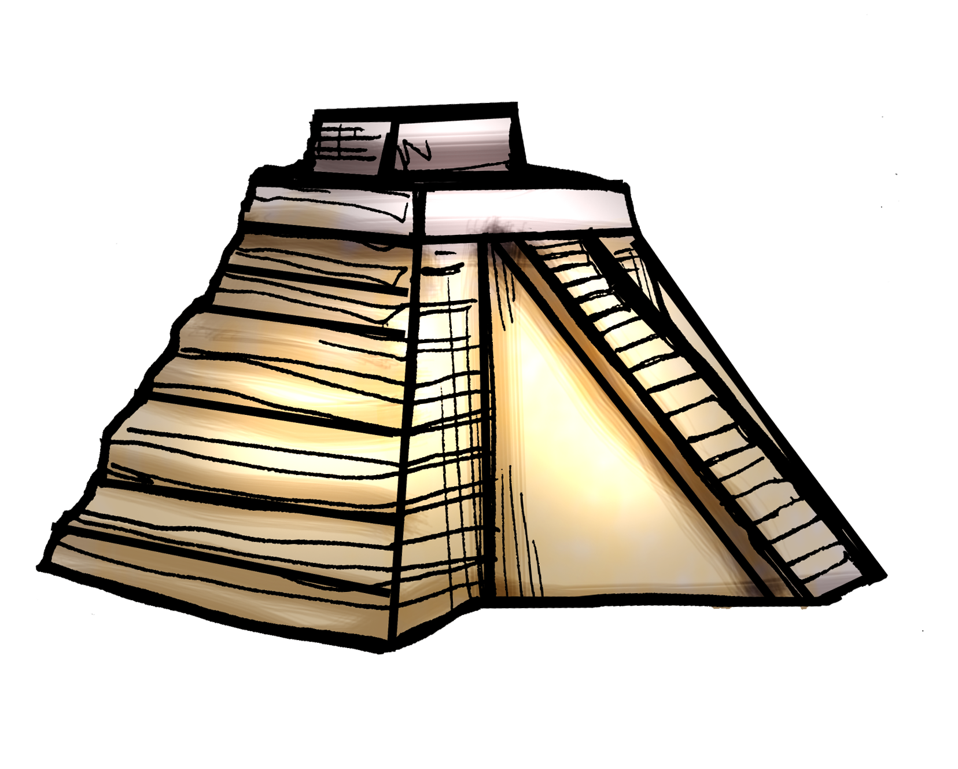

Slide 2
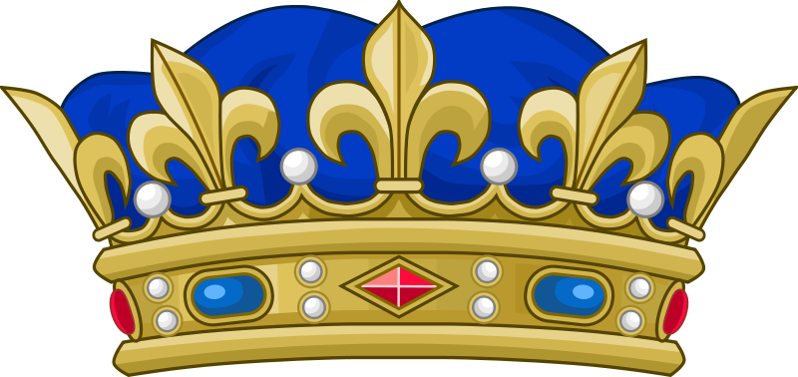
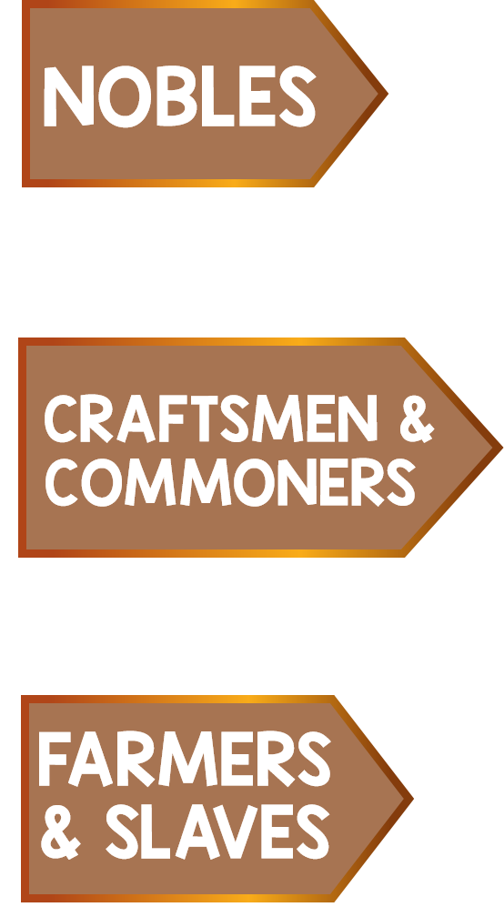
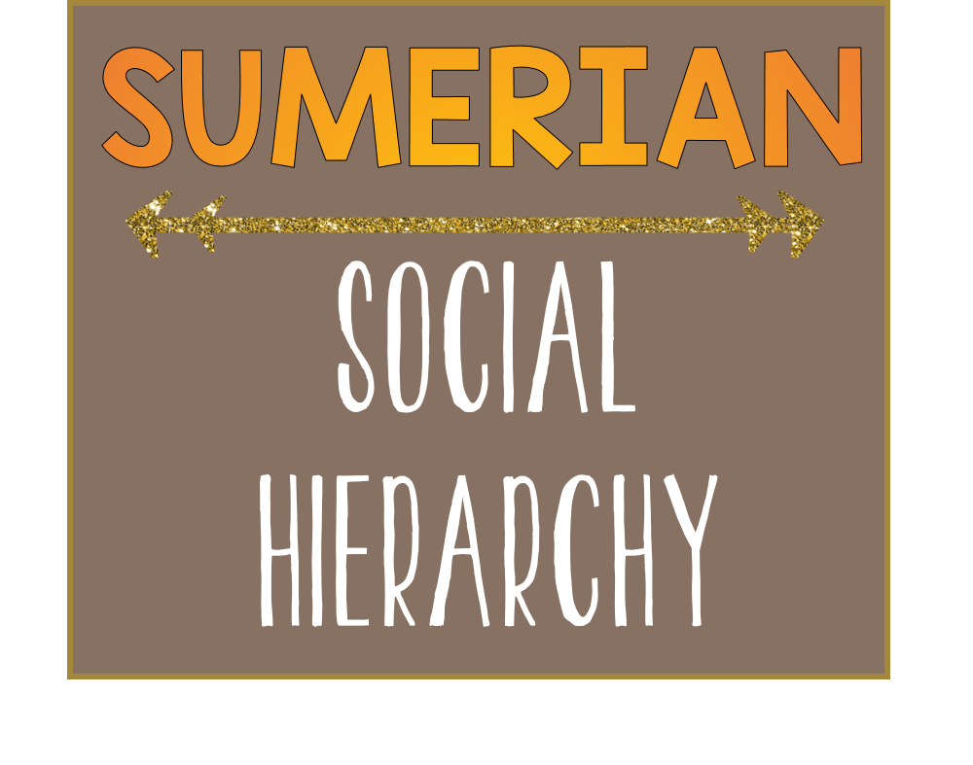
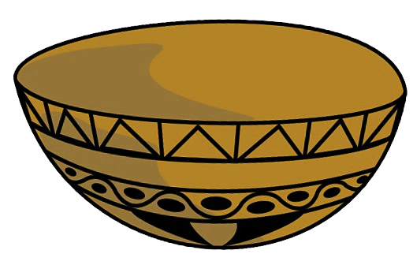
Priests, Officials, and Royals. Consists of a very small group
in the total population.
Workers for the nobles and palaces.
Held jobs involving farming, fishing, and crafting
90% of the population were farmers. Slaves mostly worked on Palace building projects and were owned by the palace.

Slide 3
